Slide 1




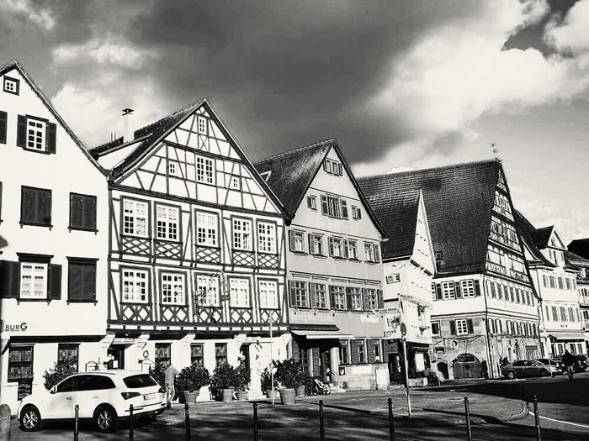
Powertrain Seminar
Operating Strategy for a P4 hybrid
Group 01

Slide 2








The Team
Keshav Sundar Venkateswaran
Raj Srivastava
Neil Ponsonnard
Shikhar Rupesh Takke
Sheng – Hsiang Wang
Albert Plens I Gorgues
Jacquelyne Tum
Viren Khaitan

Slide 3
Basic Operating Strategy
Torque priority: First Ice-torque; Remaining torque goes to the E-Drive, and the remaining torque goes to the friction brakes
The torque of each axle is limited to the maximum torque that can be transferred via the tires to the road (e.g., Body_tqAbsMaxAxFr).
The basic operating strategy switches Off the Ice at low torques, then drives fully electric with the separation clutch open.
The E-Drive does not provide torque to hold the vehicle at a slope; mechanical brakes are used.
The balancing of the state of charge (facSoc) is not yet realised in this basic version.

Slide 4
Areas for Optimization
SoC Stabilization
Better Gear Shifting Strategy
Loss minimization

Slide 5
Understand how the functionality works
Model study, breakdown of key influencing factors
Perform simulation over drive cycles
Run WLTC cycles with different facslopes (-1/0/1)
SoC Stabilisation
Identify critical regions
Very low/high SoC regions to be identified
Improve/Implement new functionality
Develop new function to maintain SoC in desired range (0,4 - 0,6)

Slide 6
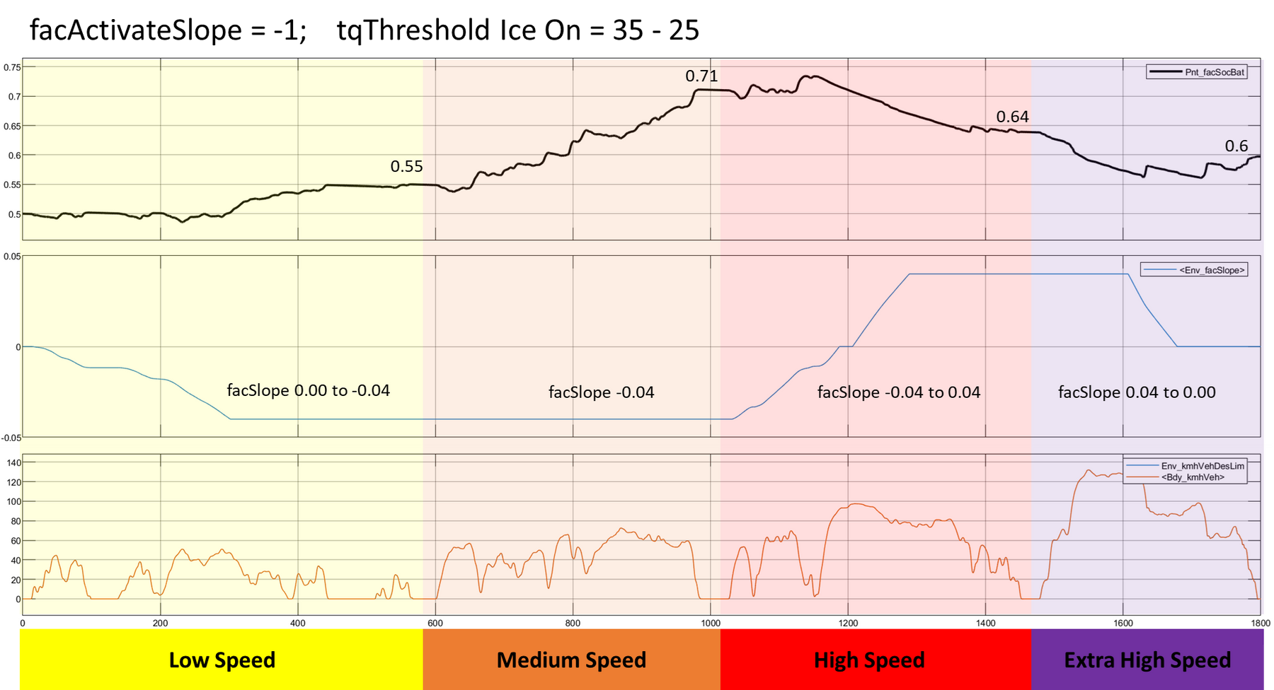
Soc-Balance by varying Switch On Torque of Ice

Slide 7
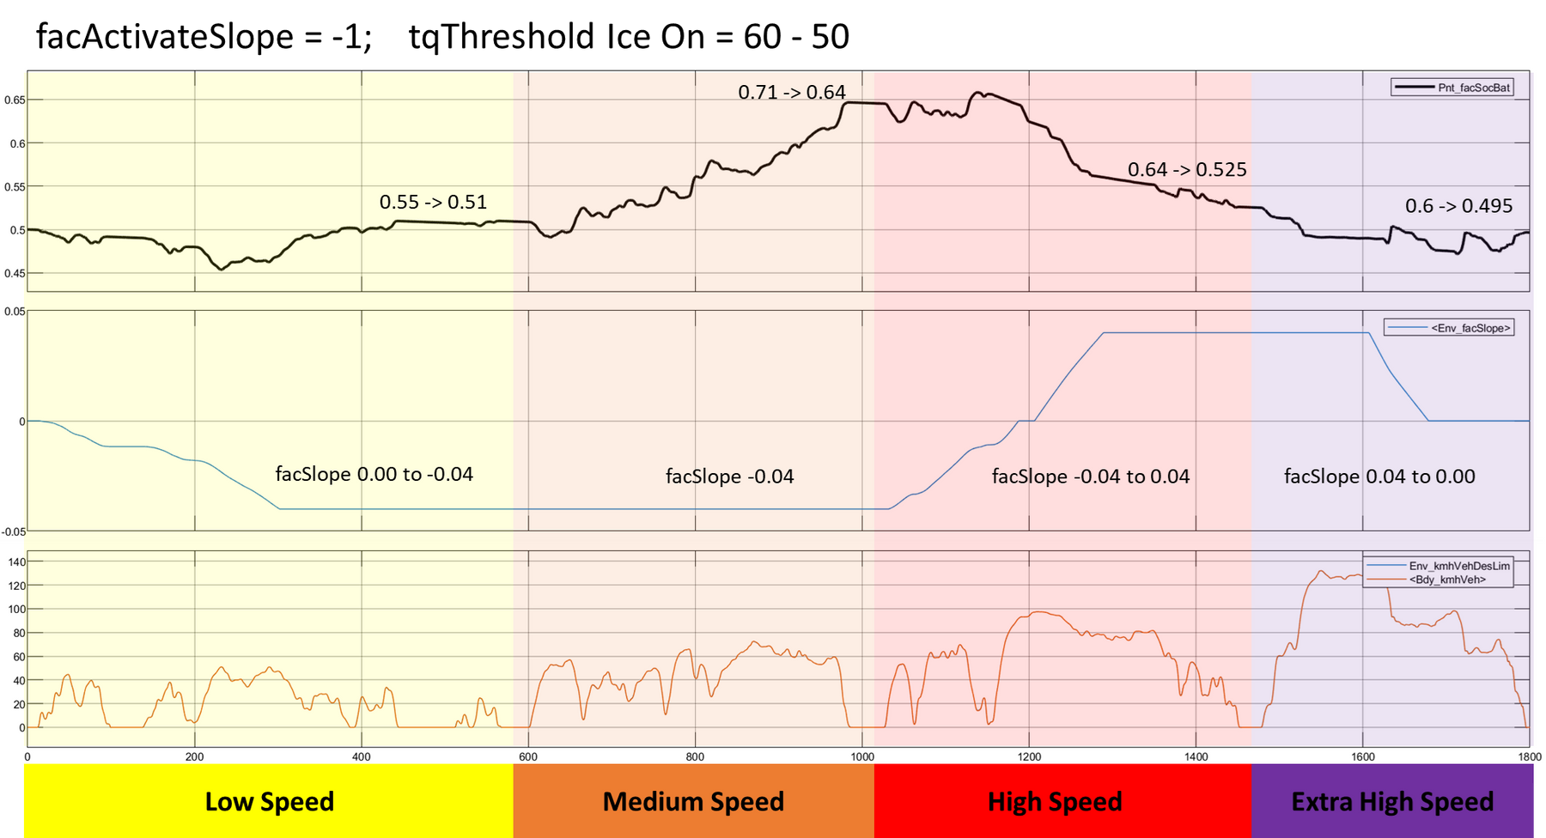
Soc-Balance by varying Switch On Torque of Ice

Slide 8
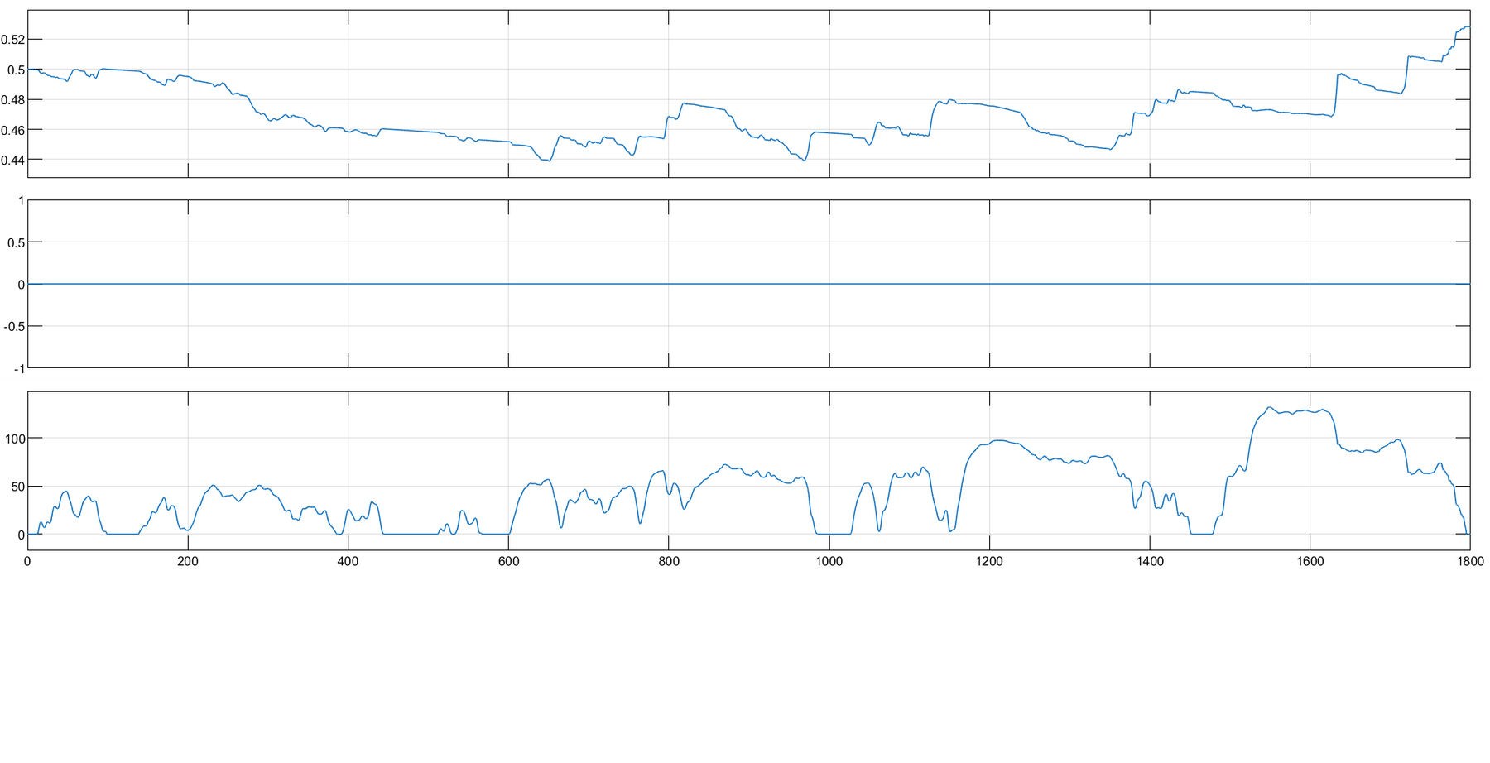
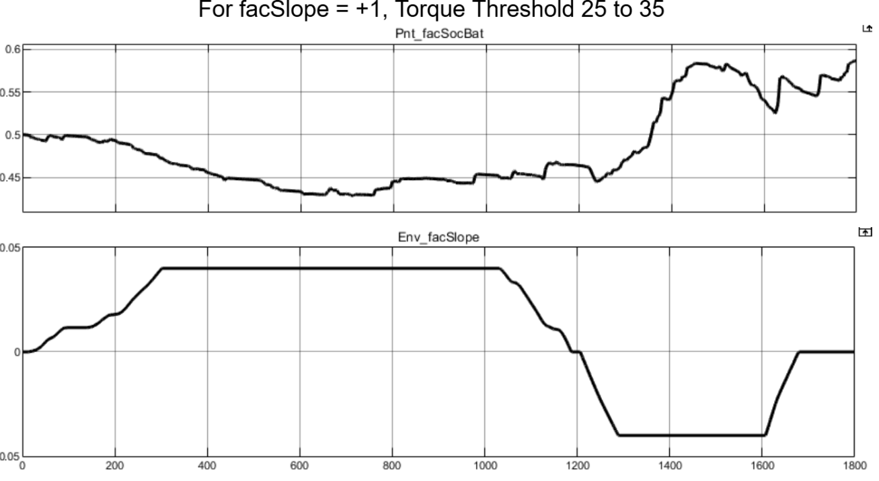
Soc-Balance by varying Switch On Torque of Ice
facActivateSlope = 0 ; tqThreshold Ice On = 35-25
facActivateSlope = +1 ; tqThreshold Ice On = 35-25

Slide 9
Soc-Balance by varying Switch On Torque of Ice
After implementing our operating strategy, the tqthreshold ICE ON values changed to:
facActivateSlope = -1 , tqThreshold Ice On = 70 - 65
facActivateSlope = 0 ; tqThreshold Ice On = 35 - 25
facActivateSlope = +1 ; tqThreshold Ice On = 45 - 40

Slide 10
Concept
Split the drive cycle into 3 regions based on slope
Positive Upward slope region >= 0%
Mildly Downhill region
0% <= slope <= -2%
Downhill region
-2% <= slope <= -4%
Develop specific 1D lookup tables for each case for each of the factors (3 facTqSoC + 3 tqDeltaSocCtrl maps)
Function receives road gradient as input; gives factors as output
Switch to the corresponding table based on the region being driven
Goal: control SoC usage between 40% and 60%

Slide 11
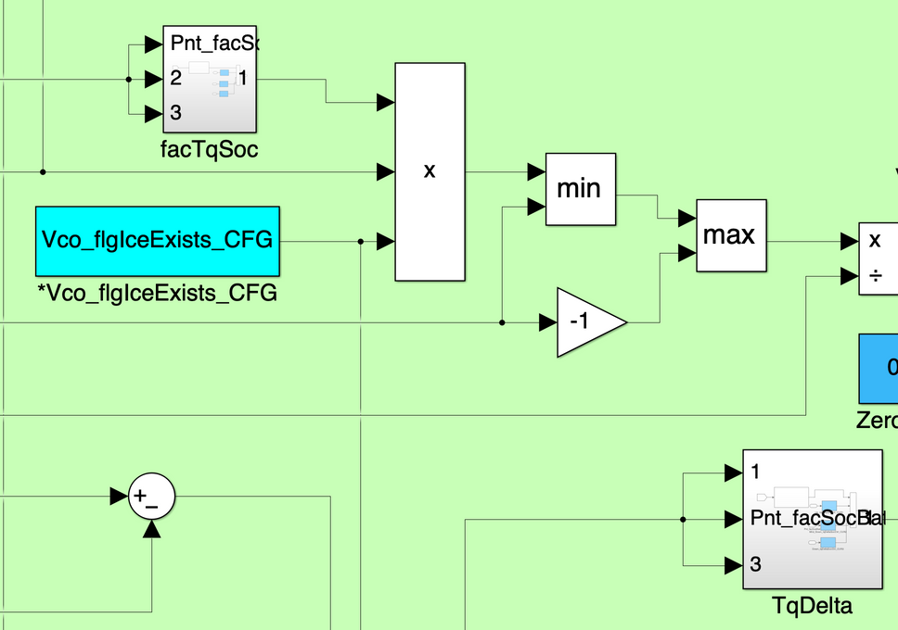
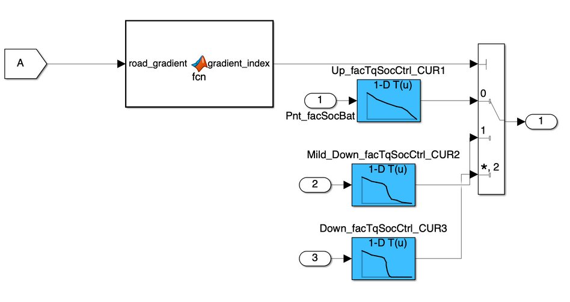
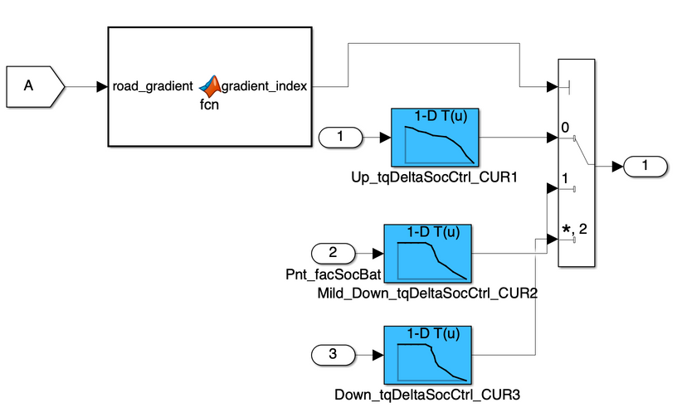
Model Implementation
facTqSoC Implementation
tqDeltaSocCtrl Implementation

Slide 12
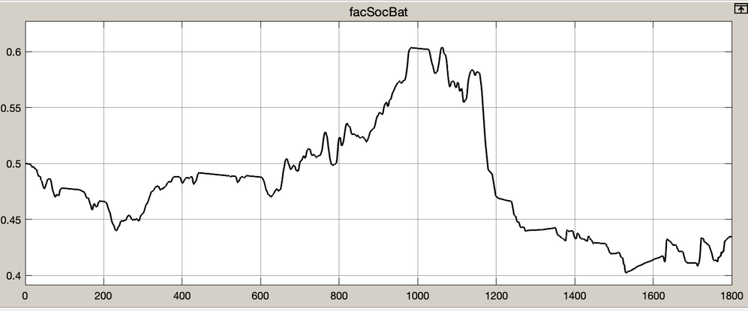
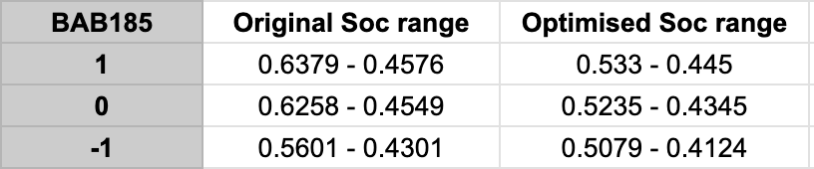
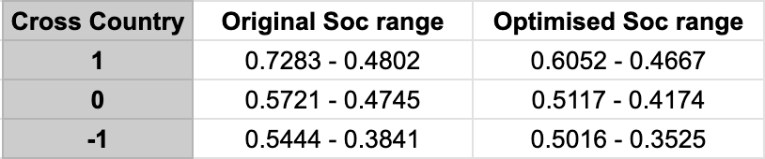
Results
0,6
0,4
SoC Behaviour for WLTC Downhill cycle (-1)
Desired target range achievable across all drive cycles
Good improvement in fuel consumption values without any compromise in power demand
New performance =Baseline for further optimisation

Slide 13
Understand & Evaluate existing Gbx Strategy
Inputs, Shifting Rules, basic effects, performance
Explore other methods for shifting
Gear Optimization Strategy
RPM-based strategies
Develop new strategy
Change from velocity - based to torque and rpm - based strategy
Validate and Test against Legacy
Check for improved, smoother performance and lower fuel consumption

Slide 14
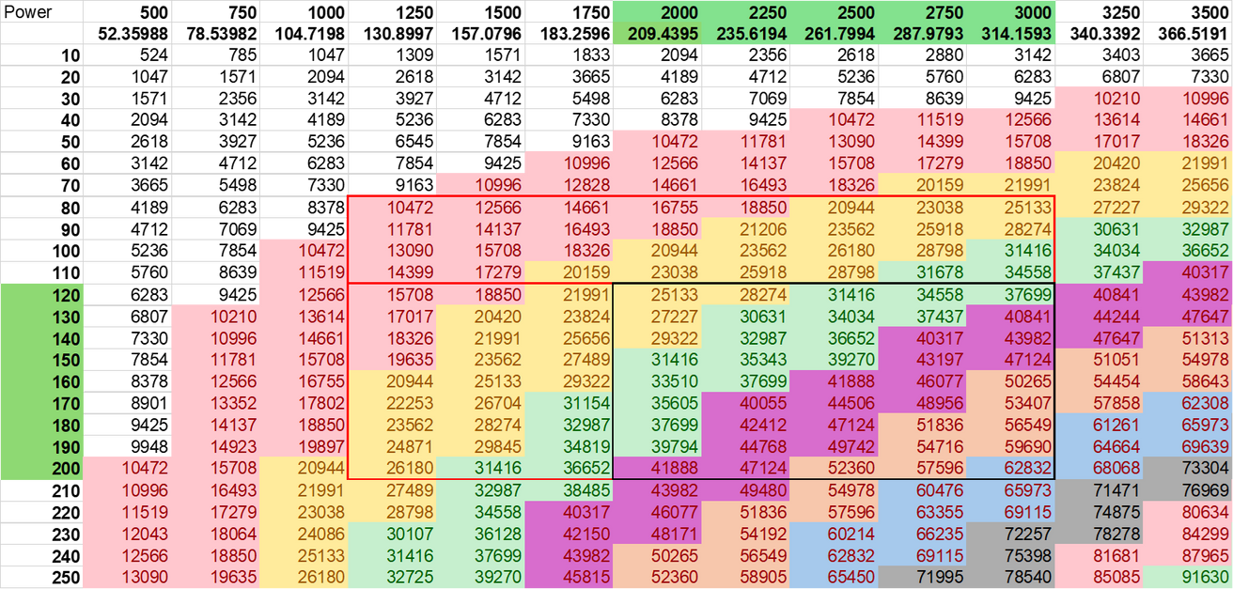
Area of sweet spot from be-map has been considered.
Power is obtained through Torque * ω
Through power-map, we can identify which powers can be achieved by running the ICE in the sweet spot.
Values from ~10kW to ~62kW.
Sweet Spot of the ICE
be ~ 260-270 g/kWh
Torque
from Power
Sweetest Spot of the ICE
be < 250 g/kWh

Slide 15
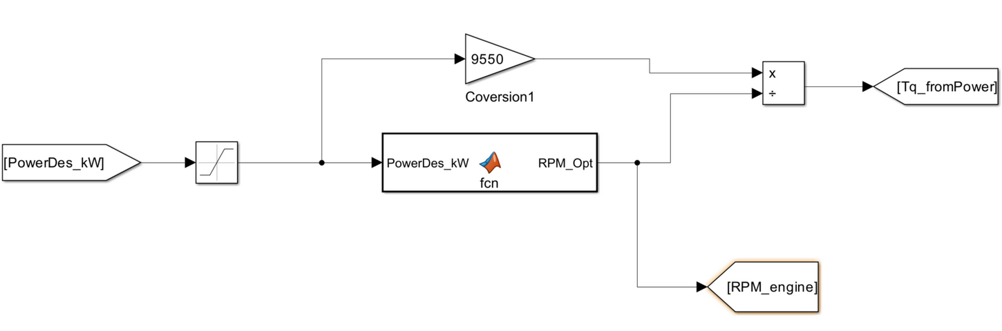
Tq_fromPwr Calculated with Matlab fcn-block:
If PwrDes lies between 10 & 25 kW: rpm_opt = 1250 rpms
If PwrDes between 25 & 50 kW: rpm_opt = 2250 rpms
Torque from Power
If PwrDes between 50 & 62 kW: rpm_opt = 3000 rpms
Else: rpm_opt = 2000 rpms (the ICE runs in the sweet spot for most torque values at 2000 rpm)

Slide 16
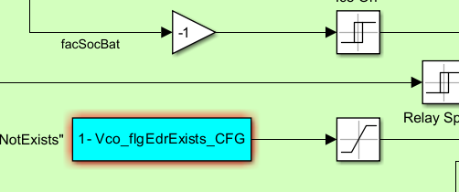
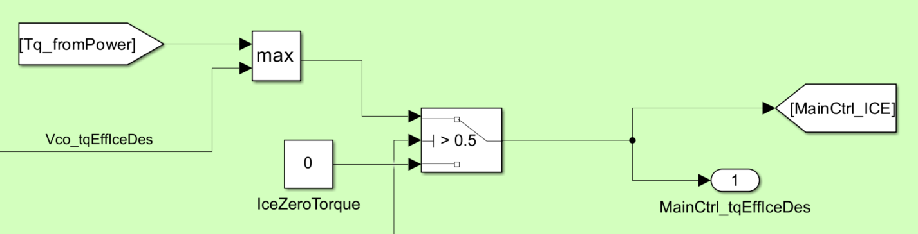

Torque provided by the ICE is decided as follows:
Torque based on Power Demand or Torque based on SOC value - decided by the Max block.
If ICE is ON ⟶ ICE has Torque
If ICE is OFF ⟶ ICE does not receive Torque
Decides ICE On/Off
Desired Torque from ICE
ICE ON or OFF depends on facSocBat, Bdy_kmhVeh, torque demand based on velocity profiles and slopes.
It worked... But not as good as the next slight change:

Slide 17
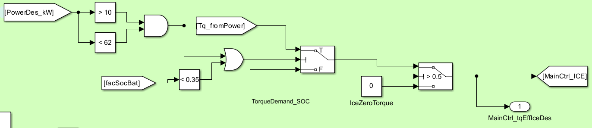

The modifications:
Max block ⟶ Switch Block
The switch checks if SoC is low OR if the powerDes is between 10kW & 62kW
Then it provides a sweet spot torque
Desired Torque from ICE
Else, it uses the SoC demand Torque
This change has reported small improvements to all drive Cycles, except for the NEDC cycle, where it consumes more fuel.

Slide 18
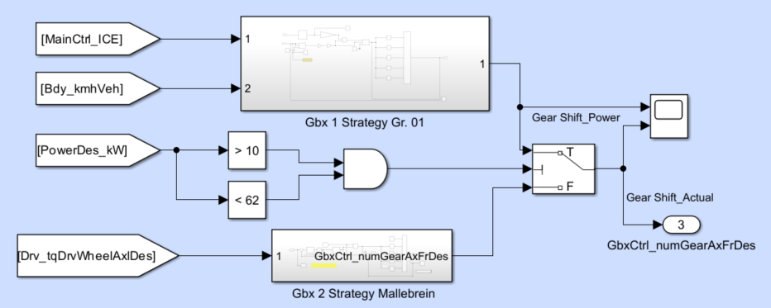
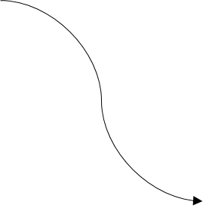
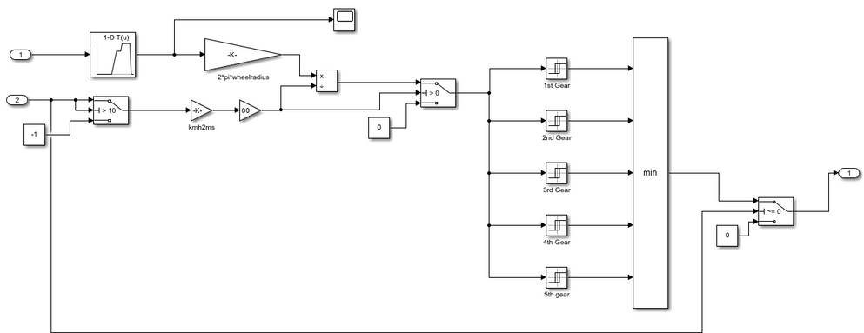
Combination of Two gear selection strategies used:
Based on gear ratio (be-map rpm based) which forces ICE to operate in the sweet spot.
Based on Bdy_kmhVeh (torque and speed based) -the original strategy - used only in case of extreme power demands
Gear Shifting

Slide 19
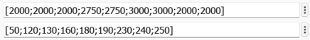
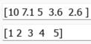
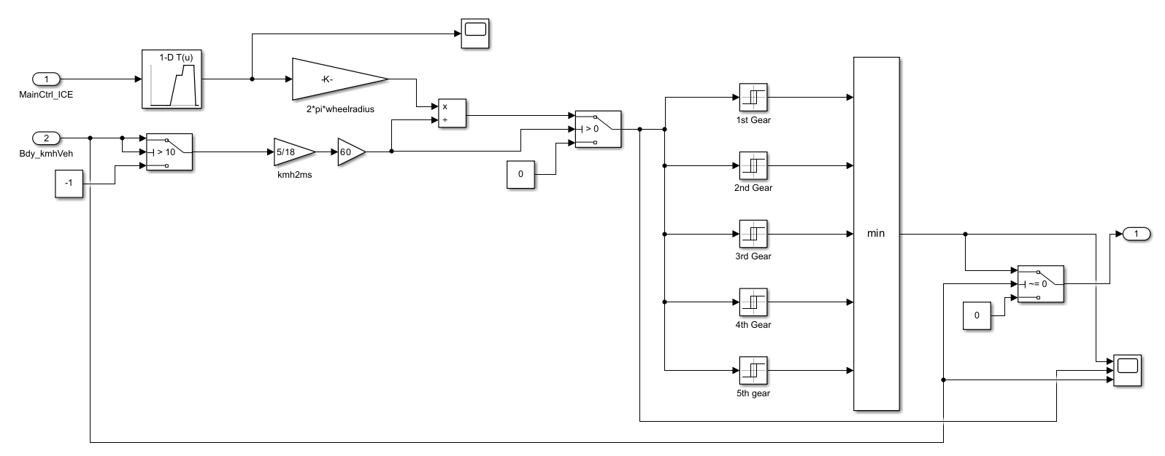
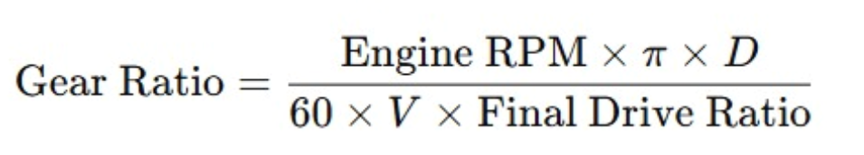
Look-up Table: Torque to RPM. From the torque, it extracts the RPMs to maintain the ICE in the sweet spot of be-map.
From Look-up table from GbxModel, it is known what is the Gear ratio for every selected gear.
Gear selector: Selects the minimum Gear Ratio, and outputs desGear
Gear Shifting

Slide 20
Understand how losses occur
Loss Minimization
ICE, E-machine and other systems
Incorporate findings in Gear Strategy
Operate at low losses w/o compromising power demand

Slide 21
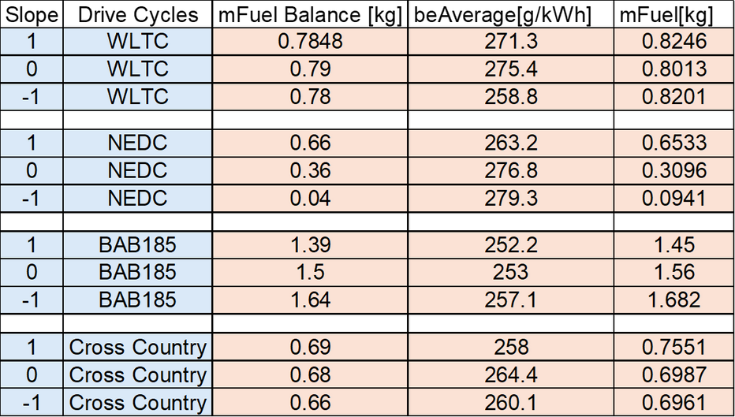
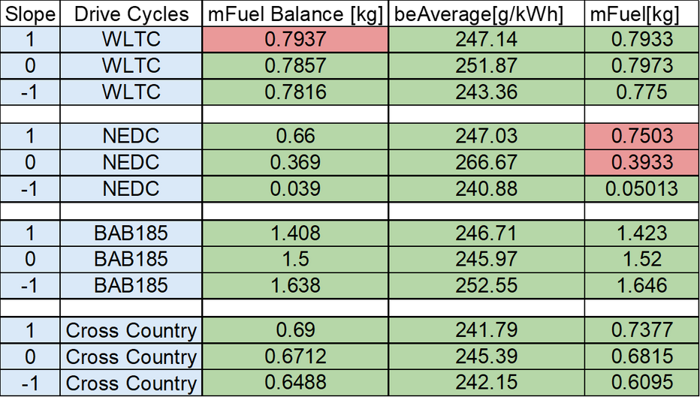
Results
Default Strategy
Optimized Strategy
The SOC of the battery lies between 0.35 & 0.69 [within the established boundaries]

Slide 22
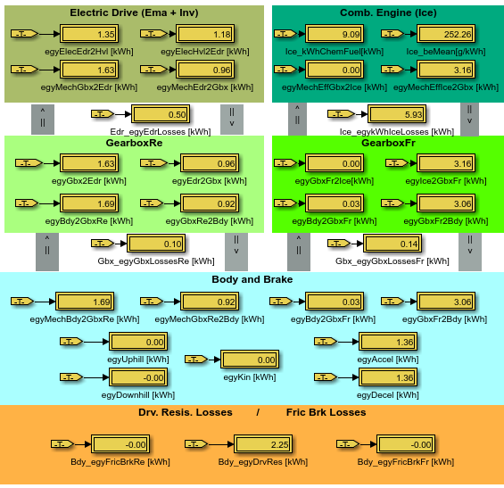
Which losses are the greatest?
Sankey Diagram helps visualize the losses of the whole system:
for all Drive Cycles w/ facSlope= -1/0/+1
Total losses ~6,7kWh:
Identified
Loss Drivers
~89% are due to ICE
~2.1% are due to Gearbox Fr losses
~1.5% are due to Gearbox Re losses
~7.5% are due to Electric Drive losses
**Overall egy_loss improvement of ~2% compared to default strategy

Slide 23
Implementing automatic threshold adjustment based on road gradient to replace the current manual switching mechanism.
The model operates near fuel-efficient regions (sweet spots) across most drive cycles; further optimization can be achieved by adapting torque demand more dynamically based on the battery's state of charge (SOC).
Gear shifting performance is generally smooth, though occasional minor gear hunting is observed, indicating potential for further refinement.
Limitations & Areas of improvement

Slide 24
Vielen Dank!

